Slide 1
TEAM 101

Slide 2

Shift-Bank needs a scalable application and partner banks and customers are seeking for actionable insights from their transactions.

Slide 3
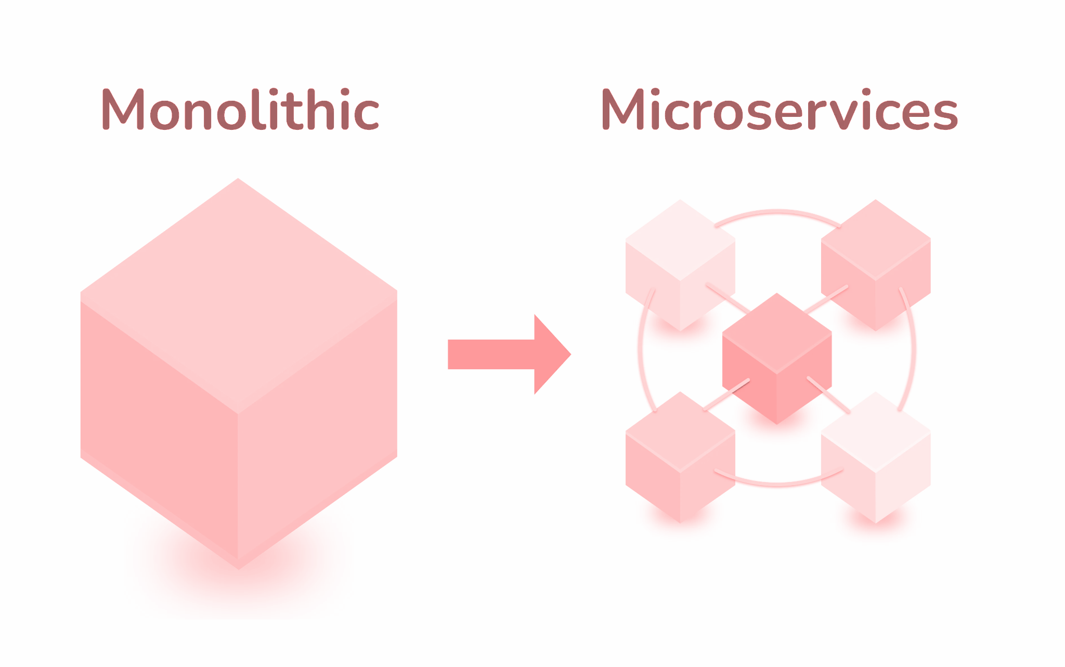
Solution

Slide 4
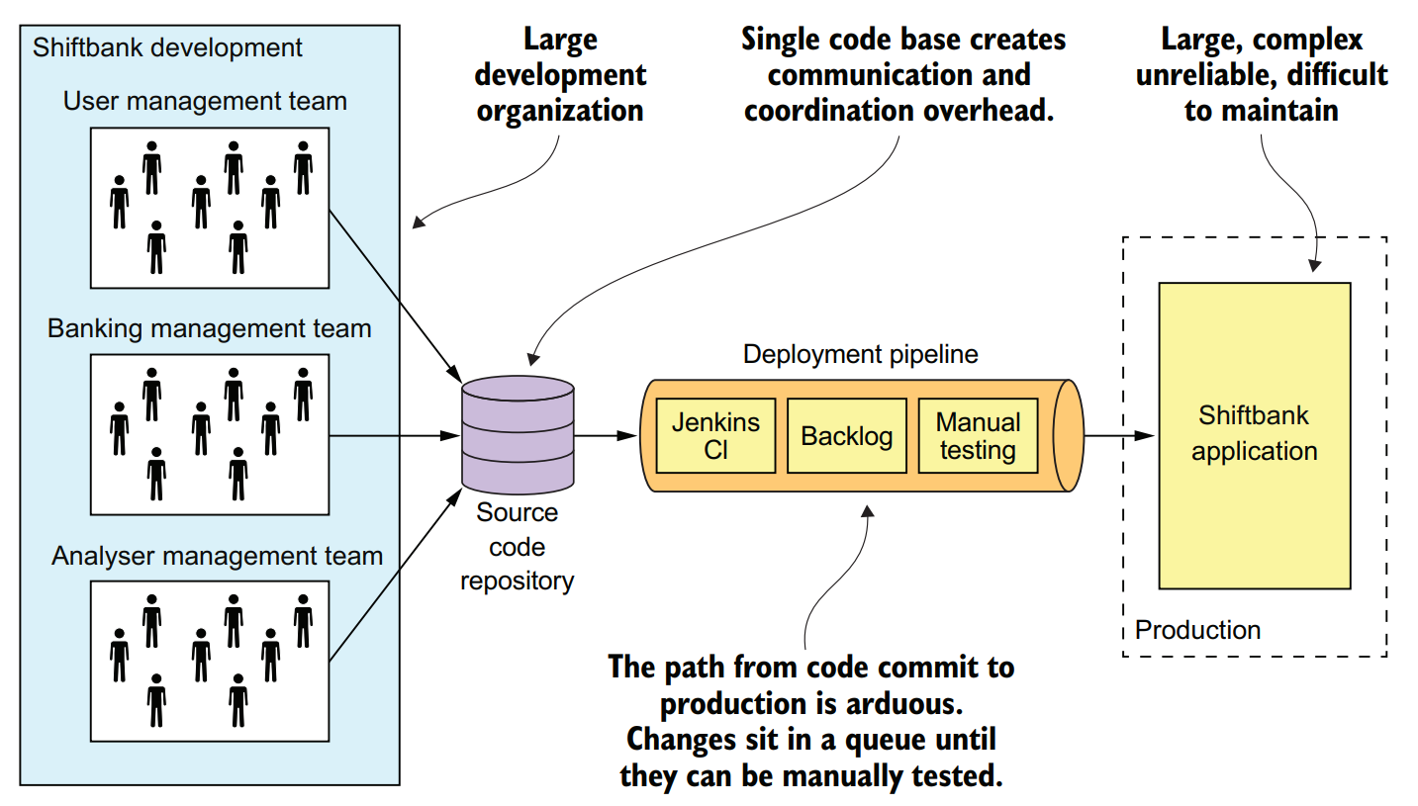
Monolithic Deployment

Slide 5
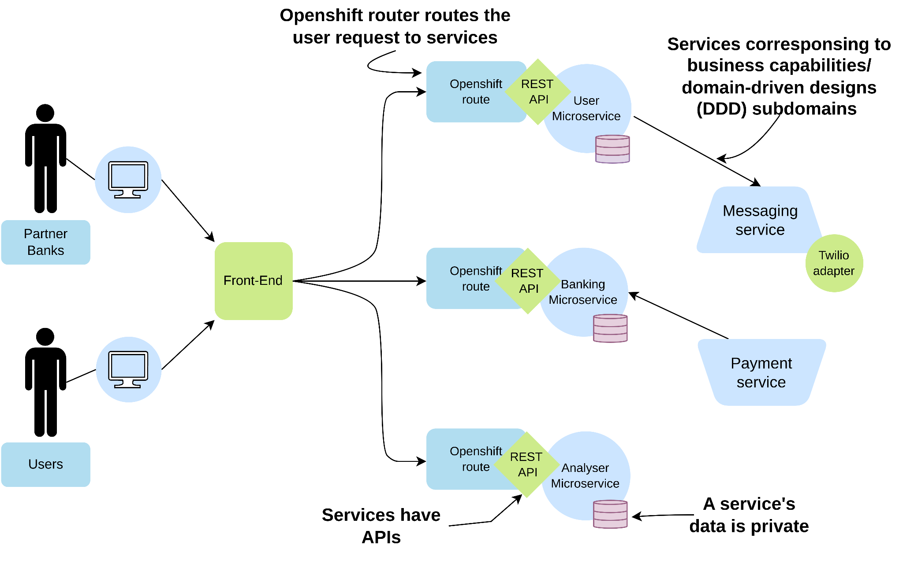
Architecture

Slide 6
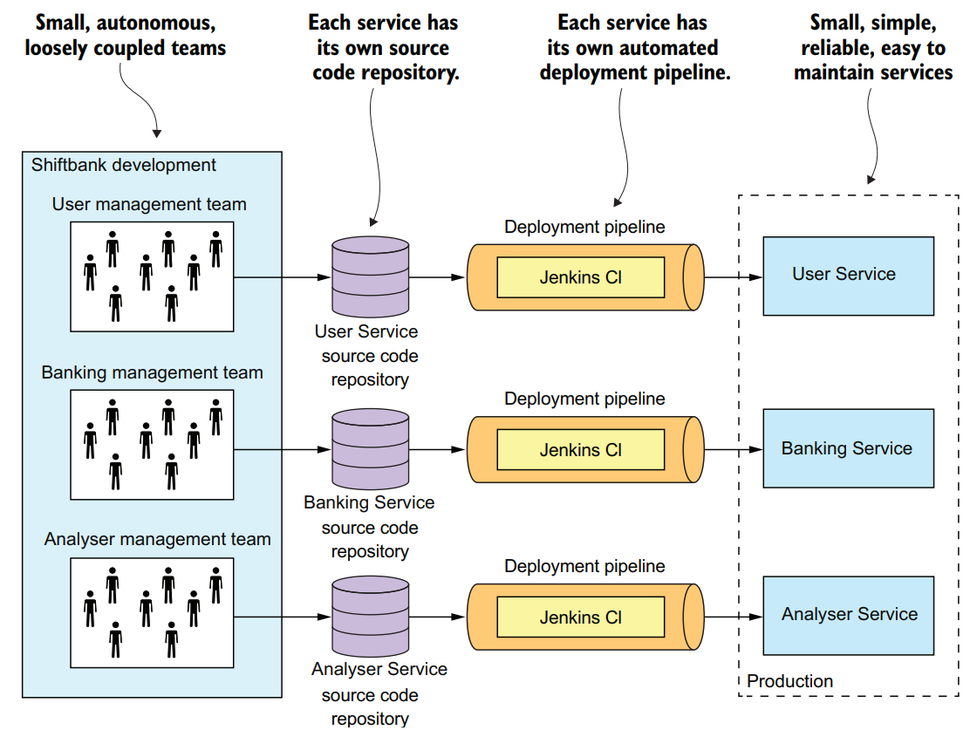
Microservices Deployment

Slide 7
OUR MICROSERVICES

Slide 8
Users Microservice
Register
Twilio Service integrated to send OTP to customer phone
Biometrics of user along with aadhar number is verified
Phone Verification
User Created
Sends OTP
Details and Aadhar Verification
Customer enters the OTP received on phone to verify phone number
After user consent, user is created with all the basic details

Slide 9
BANKING MICROSERVICE

Slide 10
Banking Microservice
User inputs basic account details. IFSC code is verified and checks on other details
Transactions are added with the payment service
Processing
Transactions
Account creation
Account Detail
Validation
Adding Transactions
Account is saved
*category and note for transactions can be added / edited. The saved transaction data can be used for analysis.
Notes:
It is responsible for storing and tracking the user’s transaction data. The user has to first create and account after adding a valid IFSC code which is verified through an API. Then we can start adding the transaction data from a payment service or

Slide 11
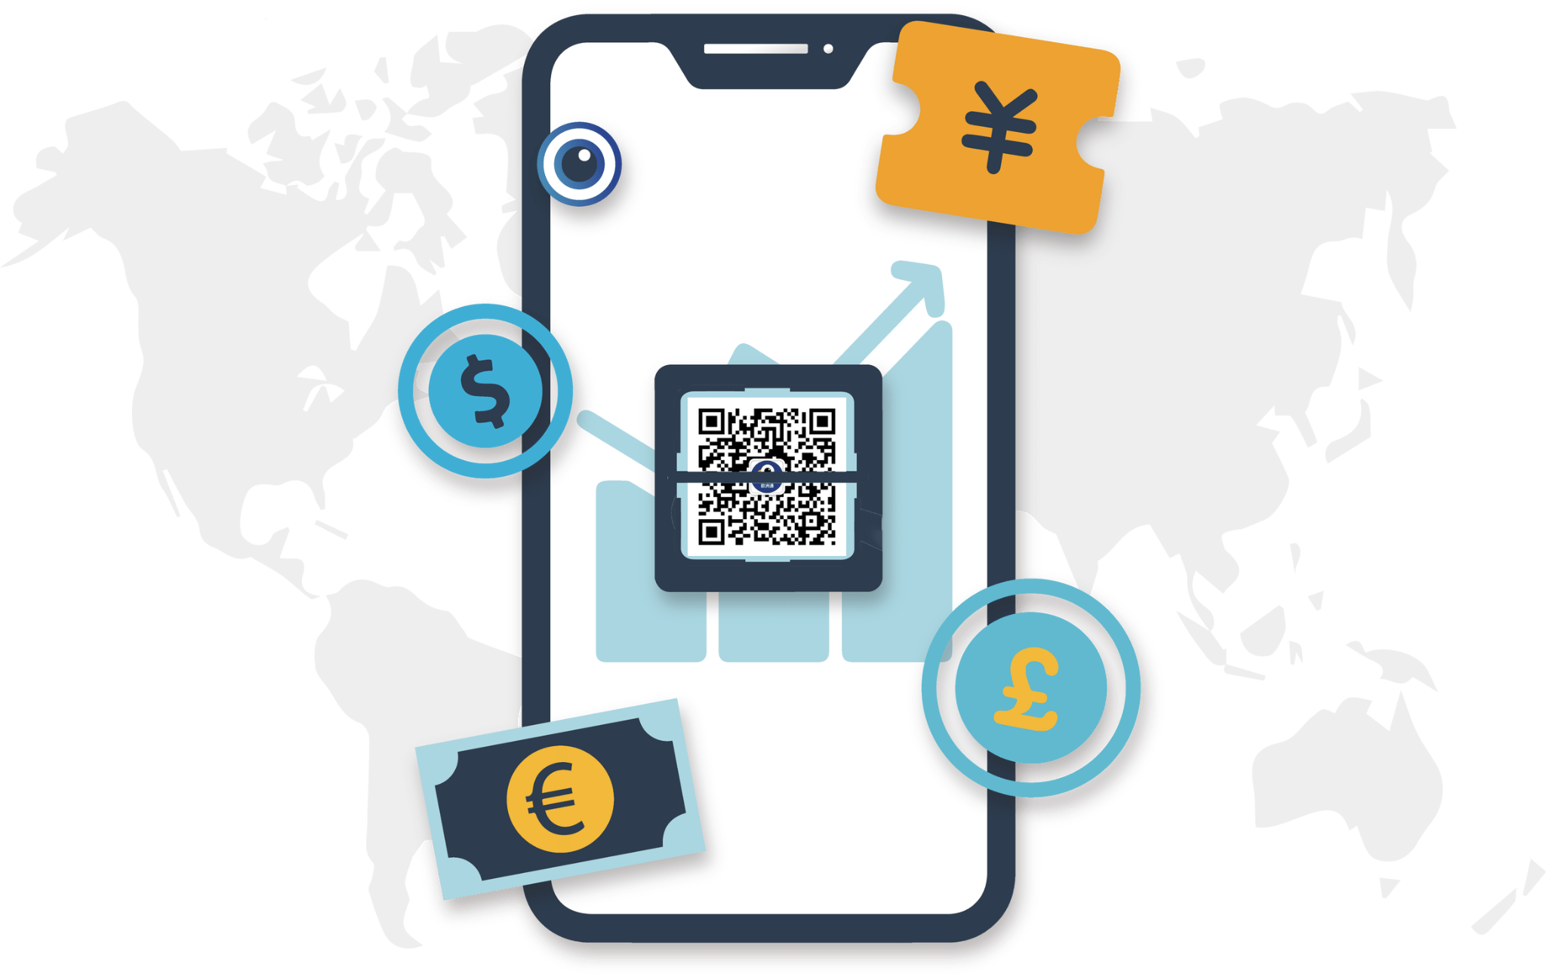

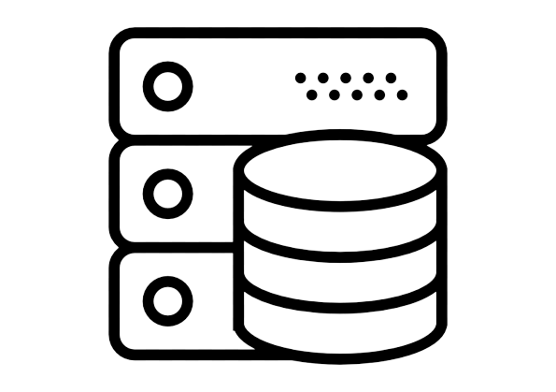

Banking Microservice
Payment Service
Banking Microservice
On-Premises Datacenter
Bank Statements
Data is stored in (month, year) format
Tracking Transaction Data

Slide 12
ANALYSER MICROSERVICE

Slide 13
Analyser Microservice
Banking Microservice
Batch 1
Processing
Analytics
Batch 2
Processing
Analyser Microservice
Client
Batch n
Processing
Parallel Processing in analysis of Transaction Data
Database

Slide 14
Analyser Microservice
Month,year 0 Transactions
Single Batch Processing
Month,year 1 Transactions
Kth Batch
Analyser
Month,year m Transactions

Slide 15
Analyser Microservice
A
N
A
L
Y
S
E
R
Monthly Income/Expense
01
02
Categorization
03
Suspicious Activities
04
Transactions Types
05
Loan Details
Debit/Credit Frequency
06
07
And Much More !!

Slide 16

Analyser Microservice
Cash Credited
above 2.5 lakhs
ATM withdrawal is above 20000
Round Figure
Tax Payment
Transaction for which balance < 0
Cheque Deposit on Bank Holidays
Computed Balance vs Given Balance
Suspicious Activities
RTGS Payment below 2 Lakhs
Debit and credit equal at month end

Slide 17
Analyser Microservice
Shopping and food
Categorization
Others
Travelling
Medical and Healthcare
Investment and saving
Utilities

Slide 18
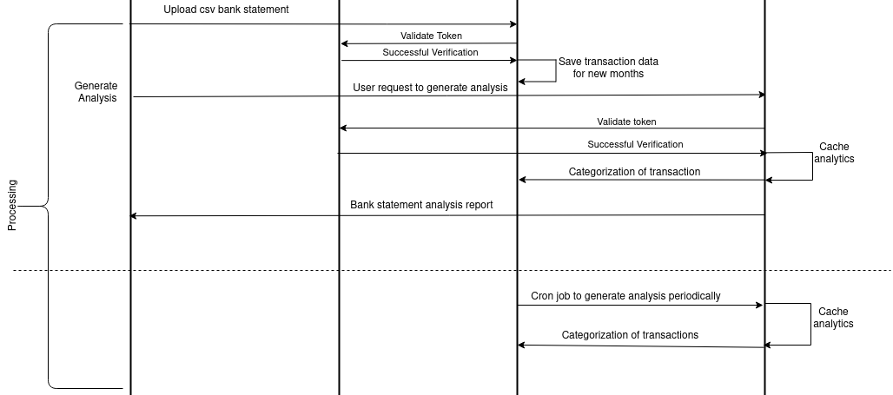
Analysis Flow
Frontend
User
Banking
Analyzer

Slide 19
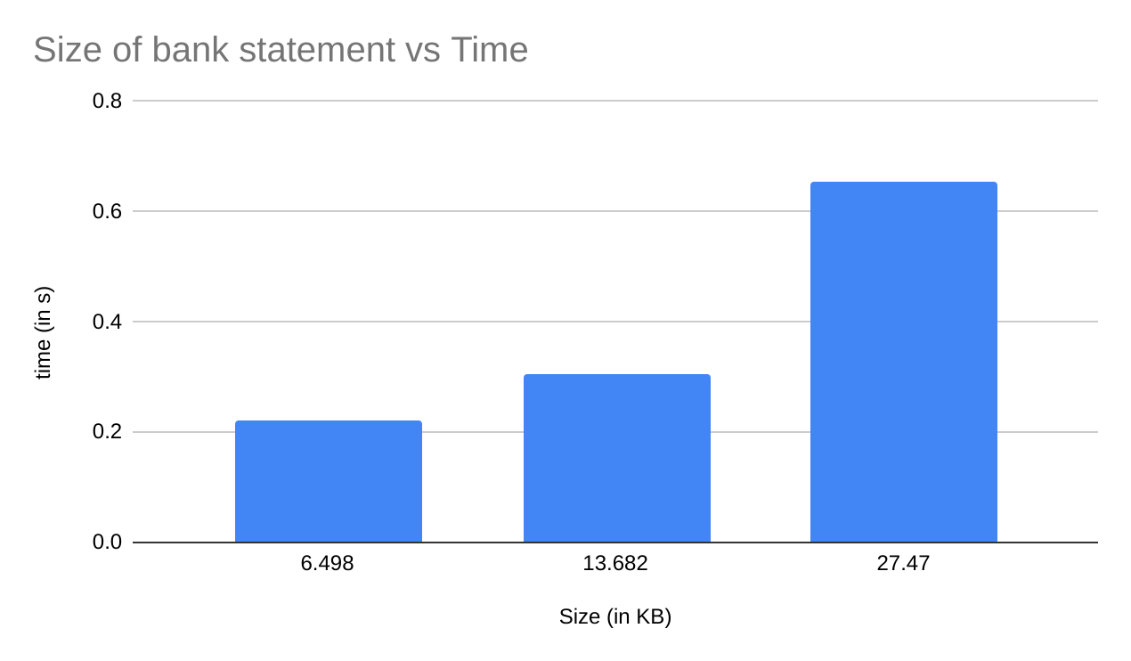
Analyser Microservice

Slide 20


Slide 21
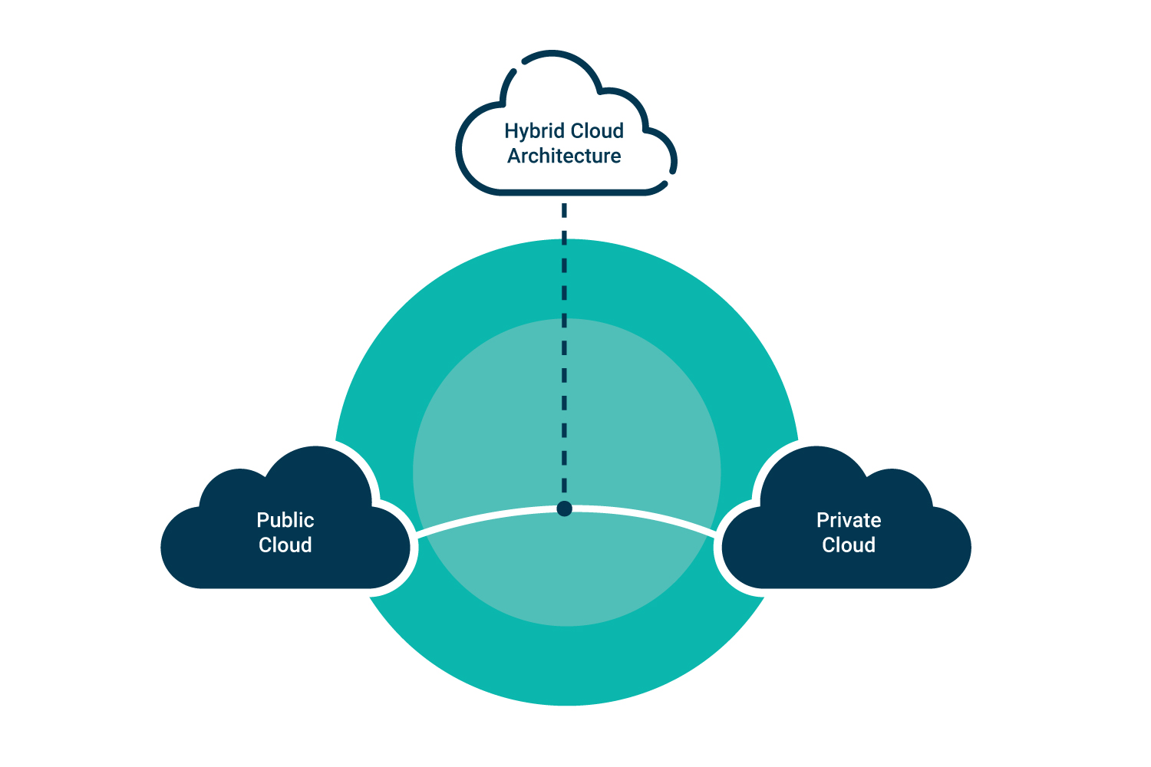
Hybrid Cloud Architecture

Slide 22
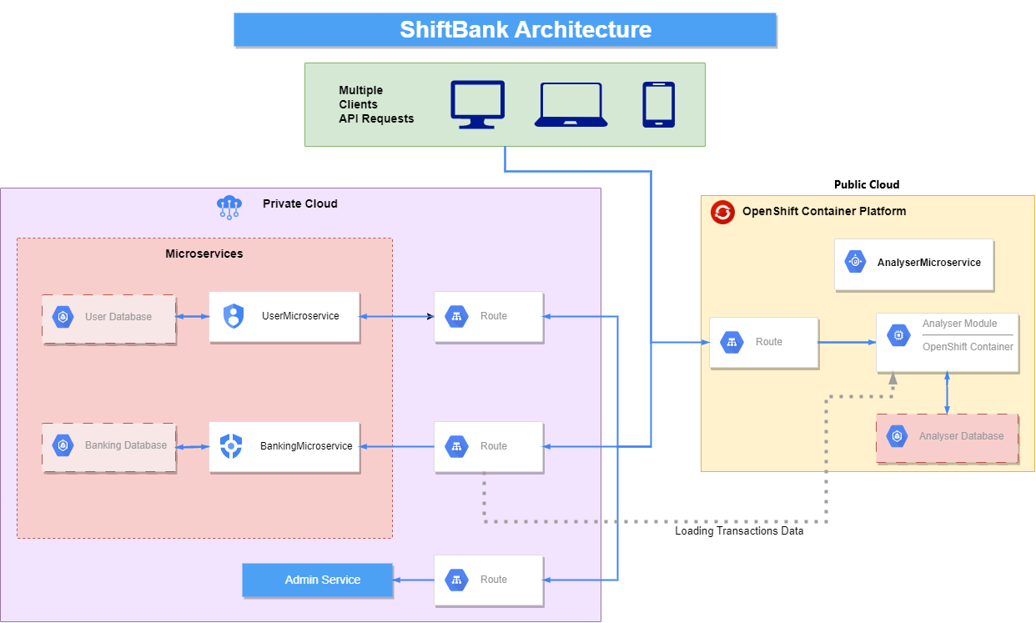
Hybrid Cloud Architecture

Slide 23




Enhanced Security
Integrated Platform
Developer Friendly
Why
OpenShift?
Built-in Automation

Slide 24
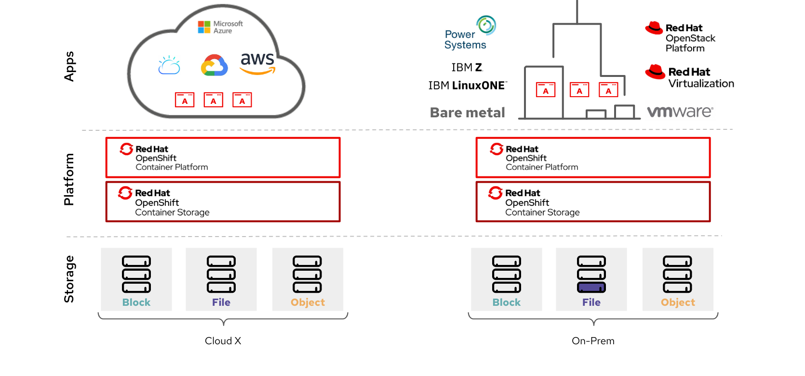

Hybrid Cloud Architecture
Analysis Data
Banking / User Data

Slide 25





Tech Stack
Banking
Users
Analyser

Slide 26
DEMO

Slide 27
Our containerised approach and use of OpenShift allows any multi-cloud combination to be used easily
A modular and extensible analytics engine has been designed
To Summarize
Each of the component in our solution can be easily and independently scaled
The entire application can be easily used and insights generated be easily interpreted via the frontend

Slide 28
Q&A

Slide 29
THANK YOU

